Slide 1

Medical Insurance Cost Estimator
Georgia Tech Bootcamp Project 4

Slide 2
THE TEAM
Karina Hutula
Ling Lu
Kyle Shimberg
Ranjani Anjur Venkatraman
Dawn Washington

Slide 3
Agenda
Introduction
Industry Outlook
Technologies & Data Source
Project Overview
Website
Insights & Next Steps
Q & A

Slide 4

OUR BIG IDEA
Our mission is to provide a nationally recognized site used by companies to predict medical costs for potential employees.

Slide 5






Industry outlook
54%
$7,470
83%
$10,966
5.3%
Average US Population with Employment-based Health Insurance
Average Paid by Employers per Employee Annually
Average percentage of healthcare premium paid by Employers
Average cost of healthcare per person in the US
Expected Growth Per Year
Success

Slide 6











Project overview
Data Source : Medical Cost Personal Dataset from Kaggle
(https://www.kaggle.com/mirichoi0218/insurance)
Exploratory Data Analysis
Regression Modeling
Deployment of the Model
Website

Slide 7

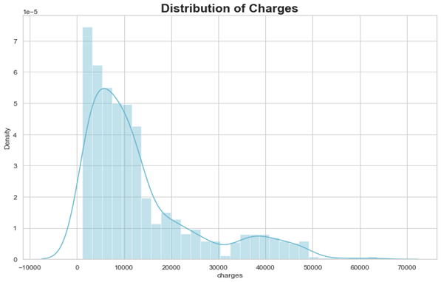
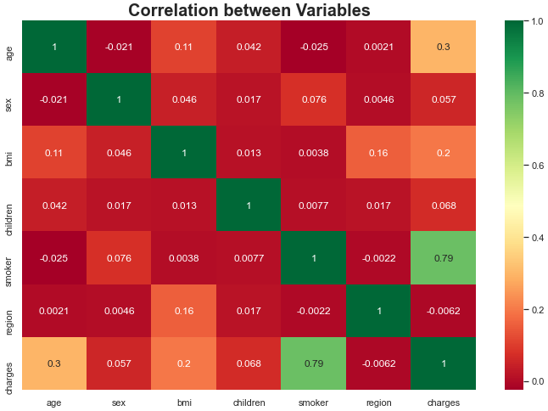
exploratory data analysis
The data has a high concentration of charges under $10,000
Charges range as high as $65,000
The strongest correlation to charges among all variables is smoker vs. non-smoker
The number of children is more closely correlated to charges then age, but not by a significant margin

Slide 8
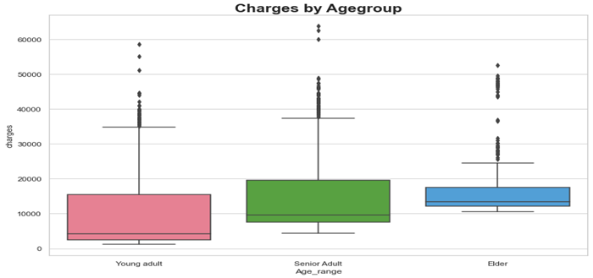
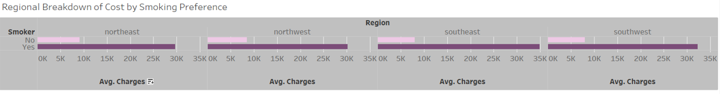
exploratory data analysis
Young adult ranges 17 to 35, Senior adult ranges 36-55 and Elder ranges all above 55
The difference of charges between the age groups is evident, but not extreme
Charges average just under $10,000 for non-smokers across all regions
Charges for smokers in the Southeast and Southwest are slightly higher than smokers in the other regions.
The differences between regions are very small.

Slide 9
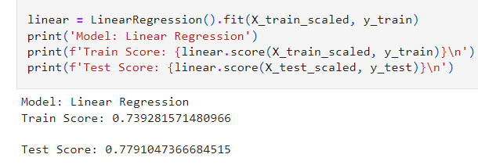
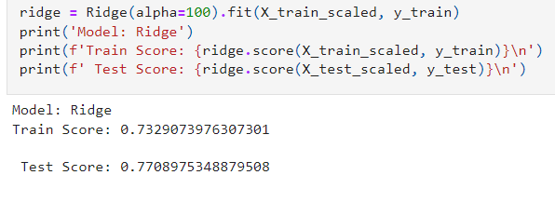
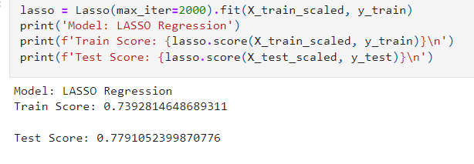
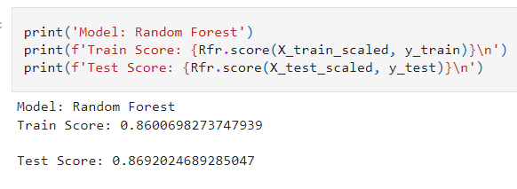
Regression Modeling
Linear Regression
Ridge Regression
Lasso Regression
Lasso Regression
Random Forest

Slide 10

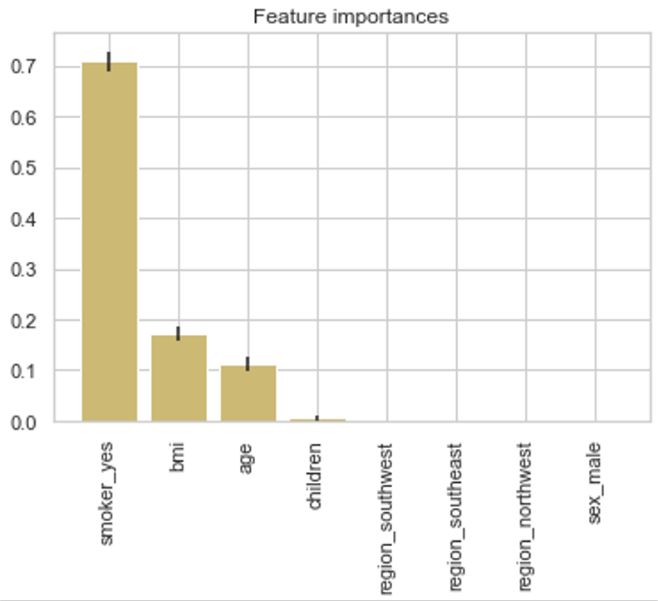
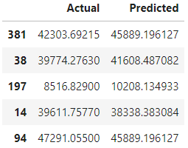
Feature Importance / Prediction

Slide 11
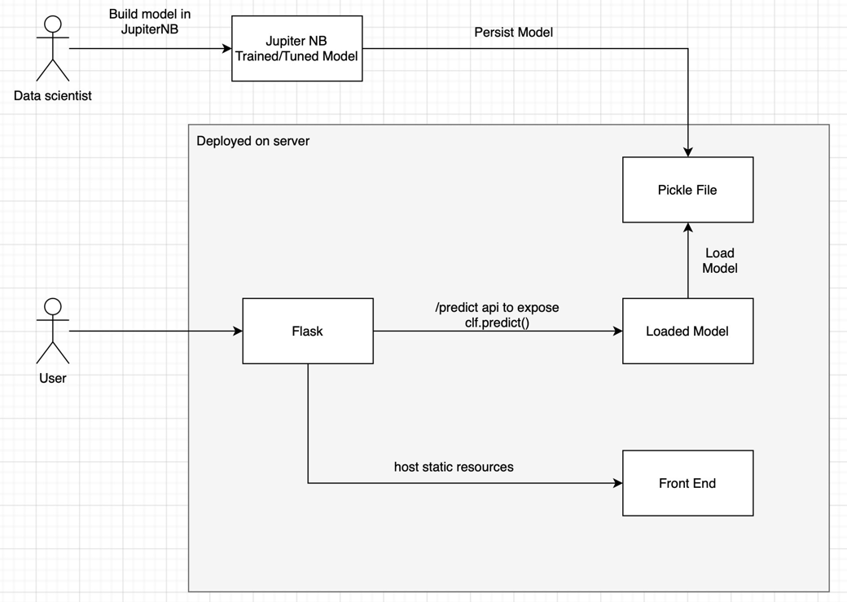
Deployment of the model

Slide 12
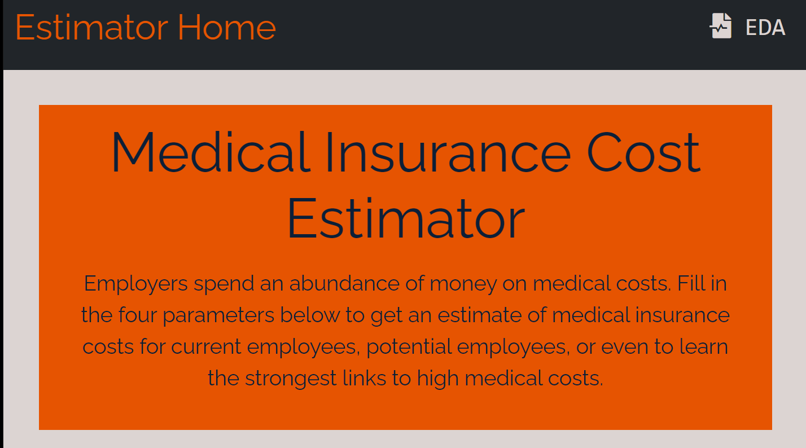

Website
https://medical-insurance-costs.herokuapp.com/

Slide 13
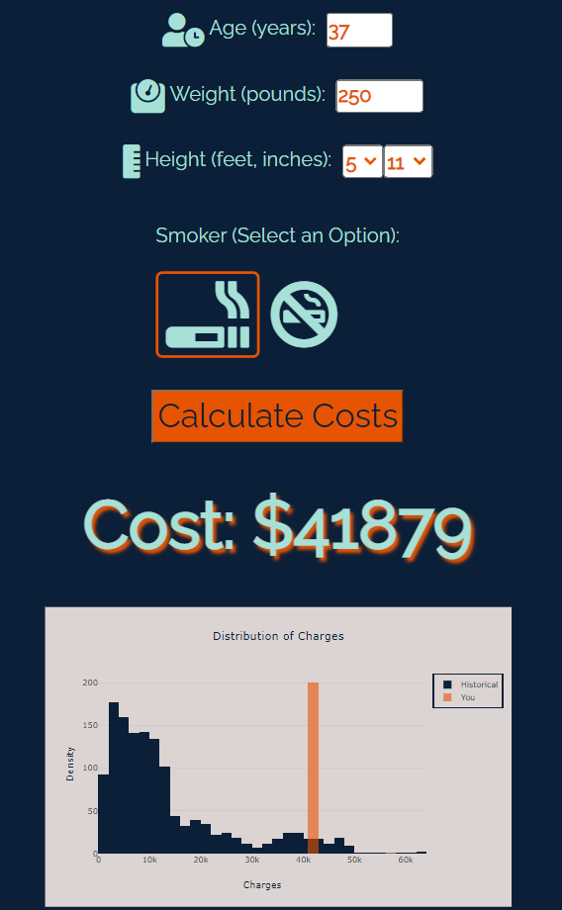
Model page

Slide 14
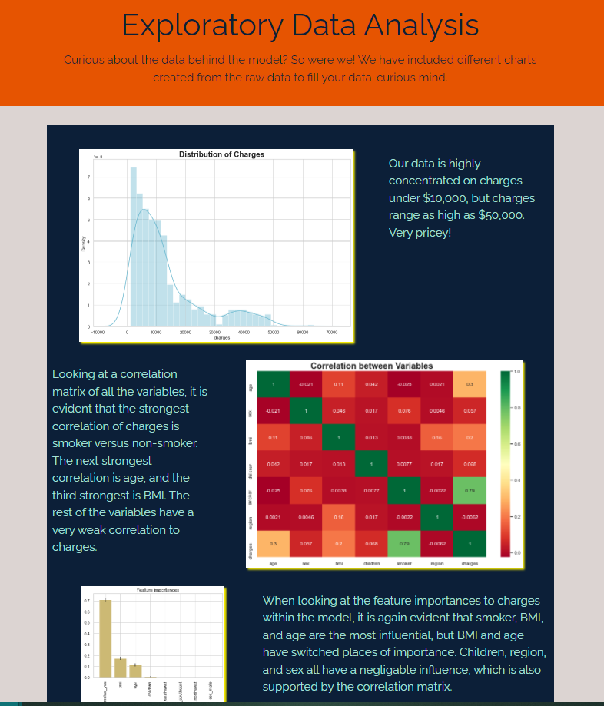
EDA Page

Slide 15

Insights & Next steps
Limitations of the dataset:
Small size of data (sample size rather than full population)
Data not recently collected and not maintained
Costs are changing by over 5% year over year, so the model would need to be maintained to address this
Additional pages expanding the exploratory data analysis
Ability to link site with widely-used human resources tools
Allow companies to upload their data to the site to improve accuracy

Slide 16

Q & A Thank you

